Slide 1
Backend
Client-Server Architecture
Notes:
Entered text
Server Components

Slide 2
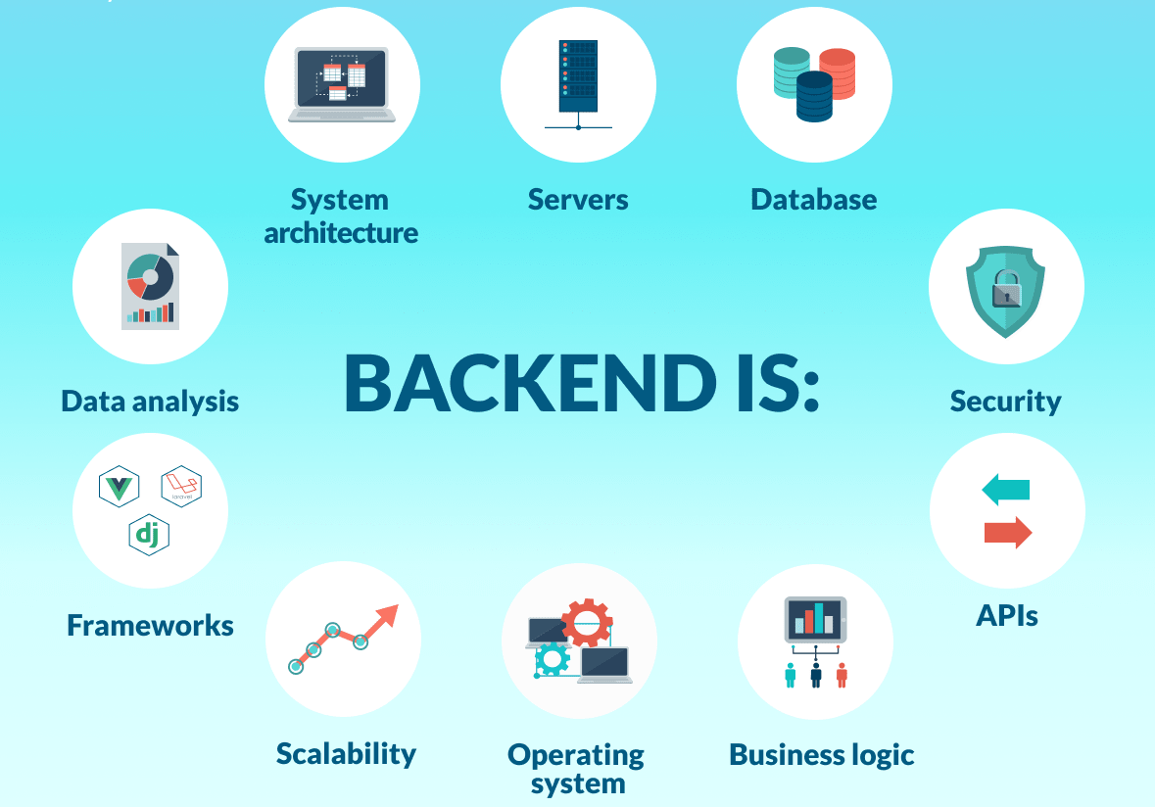

Slide 3
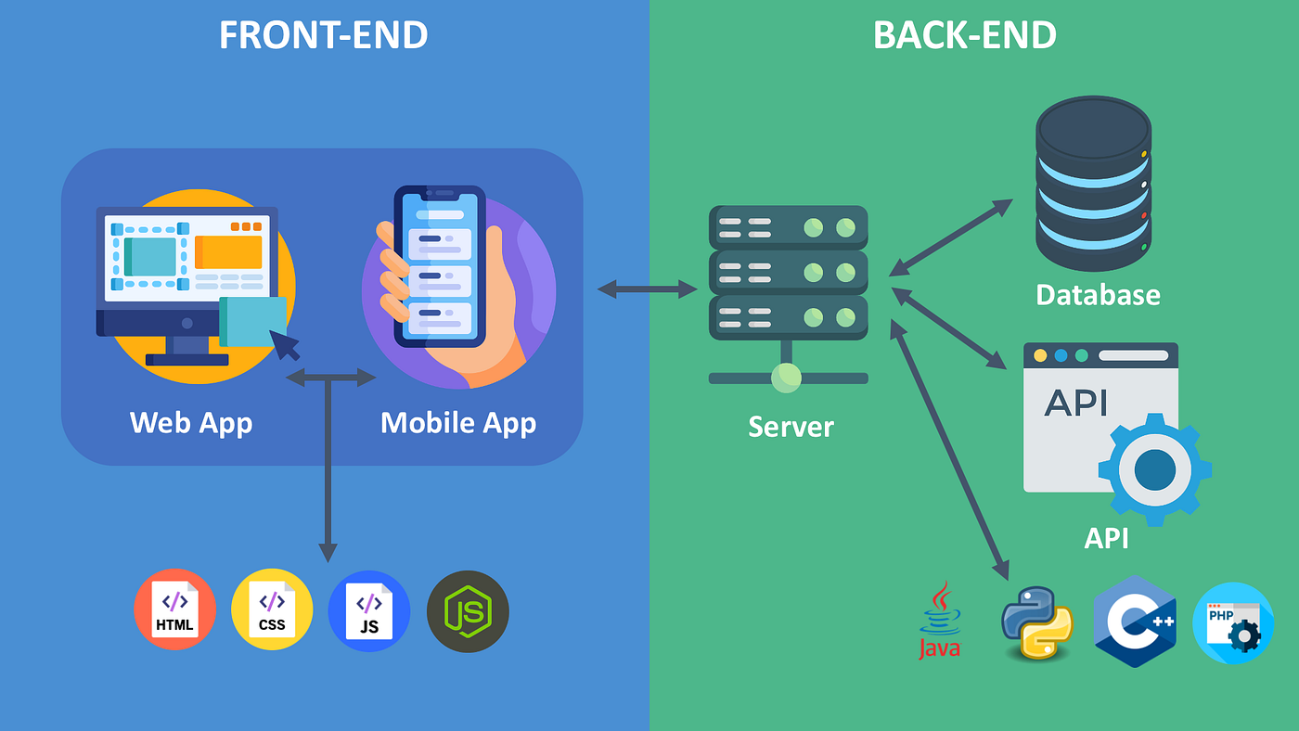
Frontend vs Backend
Displaying data and handling user events
User experience, design, and interactivity
Visible for the end-user
Runs in the user's device
Data processing, business logic and database interactions
Functionality, security, and performance
Not visible to the end-user
Runs on the server

Slide 4
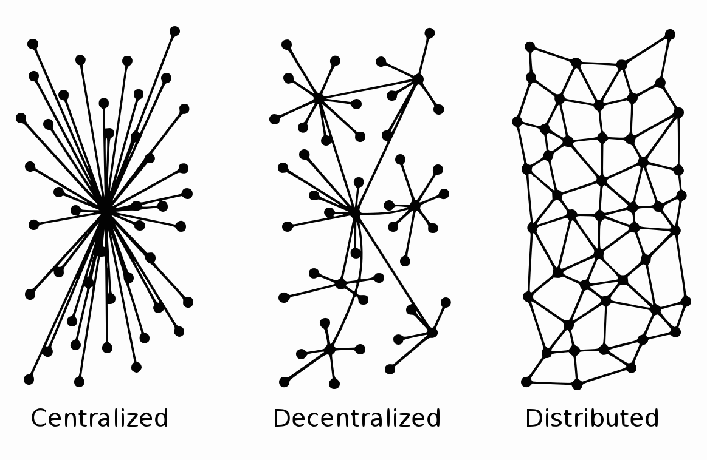
Distributed Computing Systems
Multiple systems are connected through a network to solve a common problem
Architecture types:
Client-Server
Peer-to-Peer (P2P)
Grid Computing
Cloud Computing

Slide 5
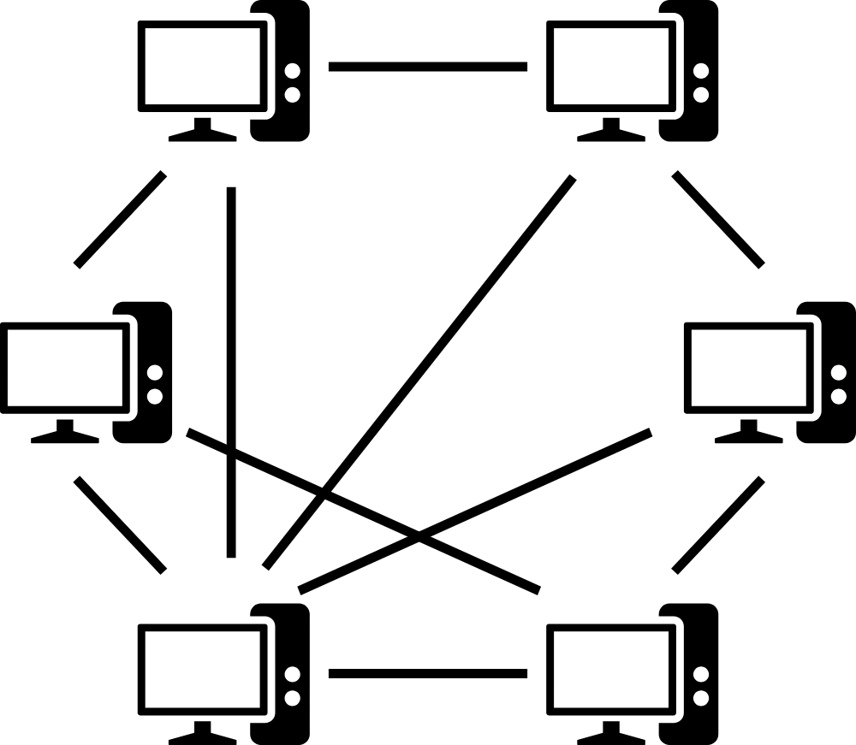
Peer-to-Peer Architecture
Decentralized distributed computing architecture
Each node (peer) is a client and a server
Works without a central coordination
Horizontal scaling by adding more peers
Applications:
File Sharing (BitTorrent)
Voice over IP (Skype)
Distributed computing
Cryptocurrencies (Bitcoin)

Slide 6
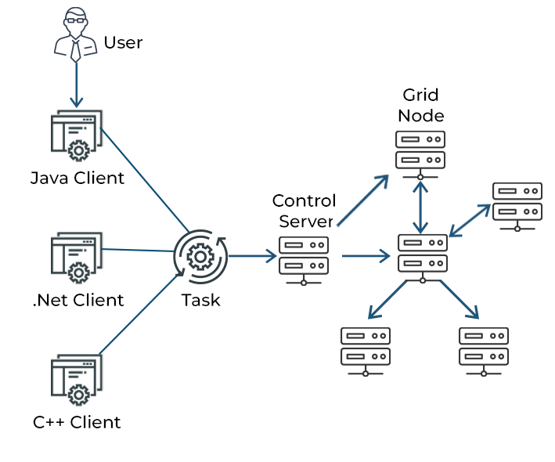
Grid Computing
Uses distributed computing resources to reach a common goal
Heterogeneity (variability of components)
Layer of abstraction hides complexity
Huge parallel processing potential
Dynamic resource management
Applications:
Scientific Research (modeling)
Engineering (simulations)
Commercial Applications (data analysis)

Slide 7
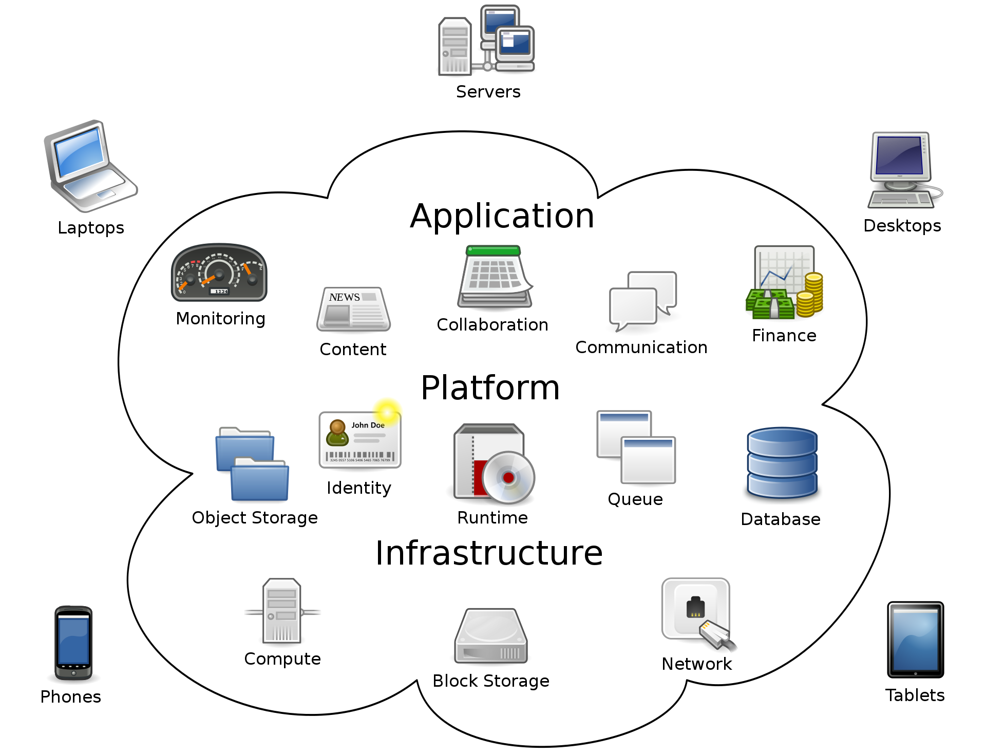
Cloud Computing
Model for delivering servers, storage, databases, networking, software, etc. over the internet
Resources are broadly accessed
Resources are pooled and shared
Resources are scaled on demand
Resources are monitored, controlled, and reported
Types:
Software as a Service
Platform as a Service
Infrastructure as a Service

Slide 8
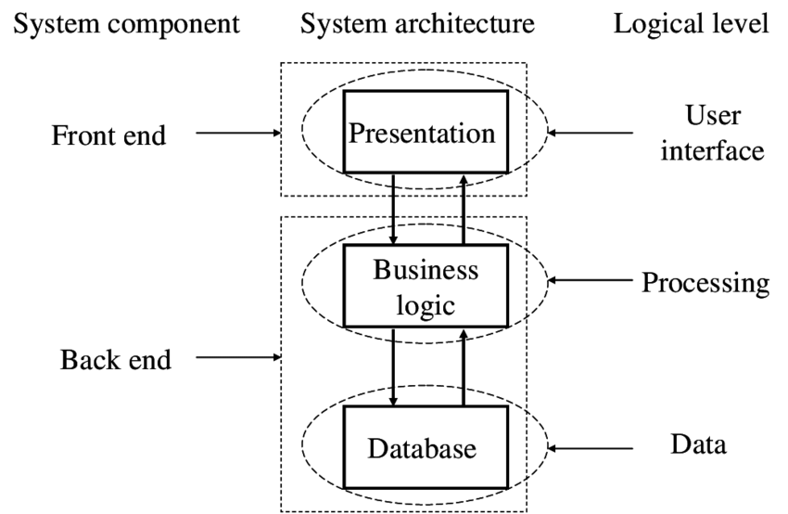
Client-Server Architecture
Application is divided into client and server
Client and server communicate over a network using protocols
Multiple clients can access shared resources on the server

Slide 9
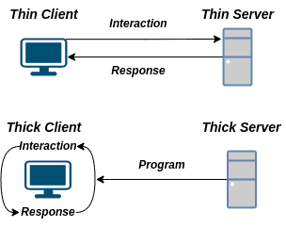
Client (Presentation Layer)
Provides user interface
Handles user input
Displays data received from the server
Performs client-side validation
Can implement caching and offline functionality
Types:
Web
Mobile
Desktop
Command-Line
Internet of Things (IoT)

Slide 10
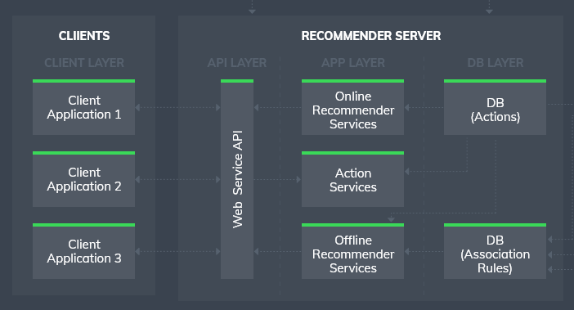
Server (Application Layer)
Receives and processes requests from clients
Implements the core business logic
Performs operations on data
Structure:
Web server (nginx)
Application server (puma)
Framework (Ruby on Rails)
Data Access Layer (ORM, Adapter)

Slide 11
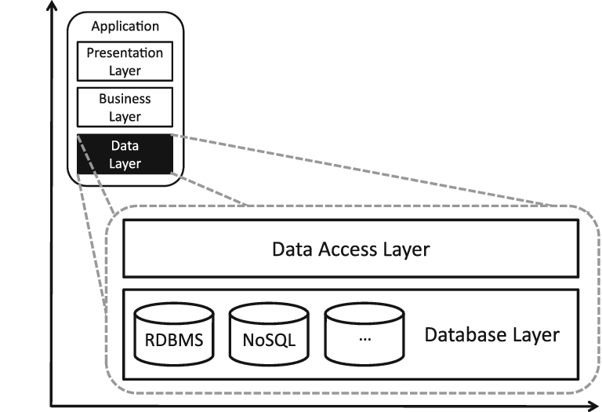
Data Layer
Managing and storing the application's data
Ensures data consistency, accuracy, and reliability
Ensures data security
Components:
Databases
File Systems
Caching Systems

Slide 12
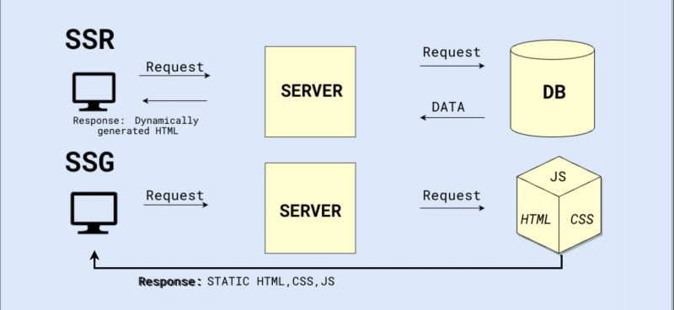
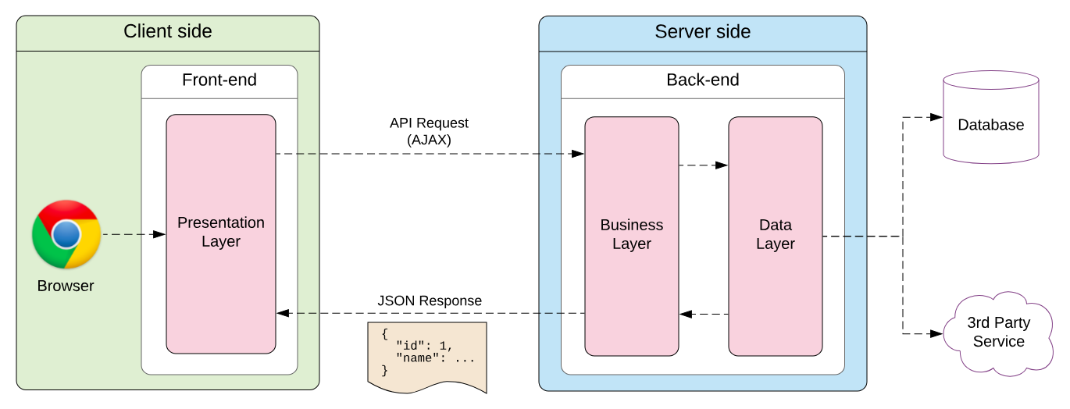
Client Architecture
Server-Side Rendering (SSR)
Static Site Generation (SSG)
Single-Page Application (SPA)

Slide 13
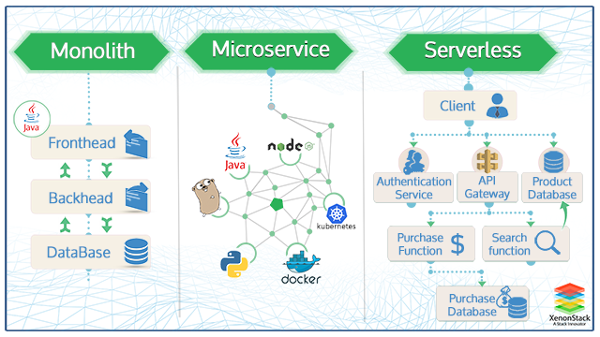
Server Architecture
Monolithic Architecture
Microservices Architecture
Service-Oriented Architecture (SOA)
Event-Driven Architecture
Serverless Architecture

Slide 14
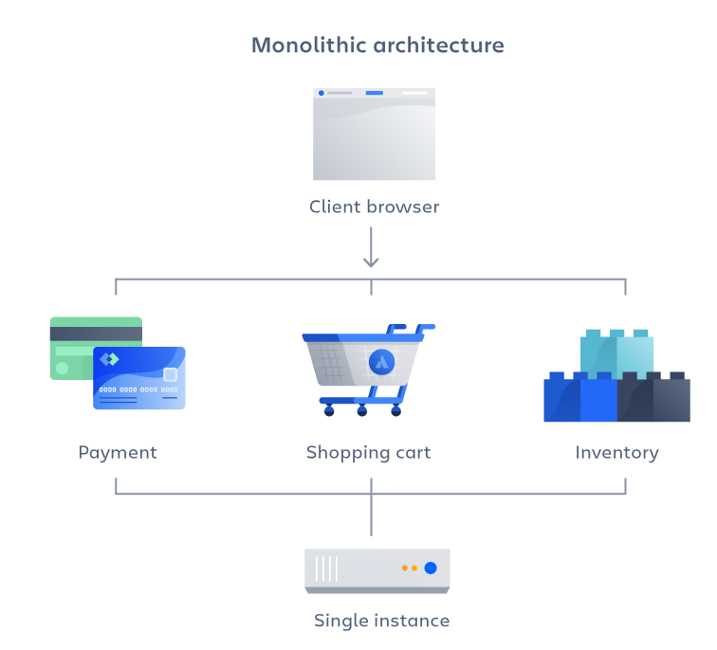
Monolithic Architecture
Application is developed as a single unit
Simple deployment
A lot of dependencies
Scaling is done by allocating an entire app

Slide 15
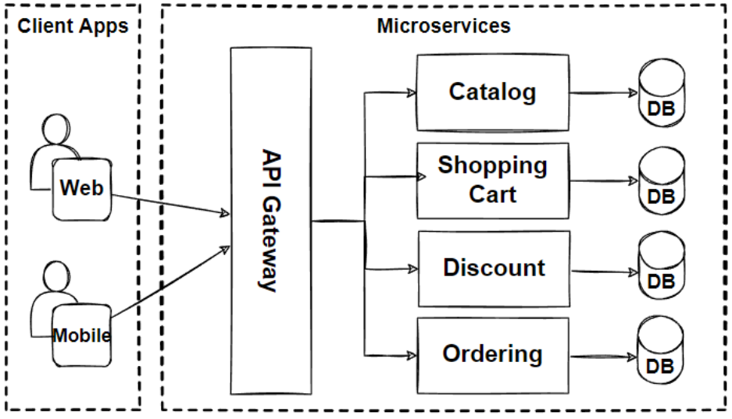
Microservices Architecture
Application is decomposed into smaller services
Services communicate through APIs
Services developed, deployed, and scaled independently
Services can use different technologies
System is resilient because of isolation

Slide 16
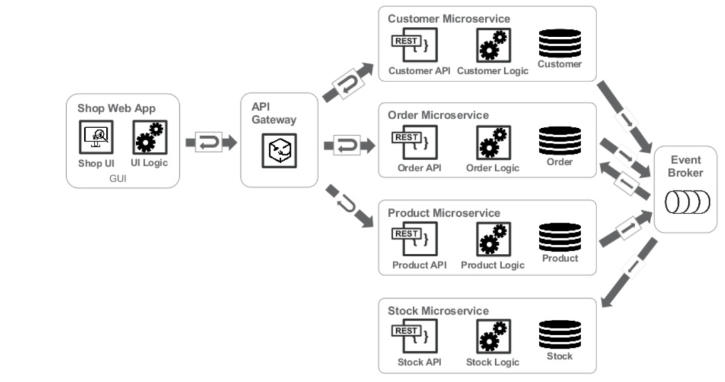
Event-Driven Architecture
Flow of information is based on the occurrence of events and the reactions to those events
Components:
Event - change in the system or business domain
Event Producer
Event Consumer
Event Broker - mediator of the communication
Components interact asynchronously
Events are processed in real-time
Event ordering may cause racing

Slide 17
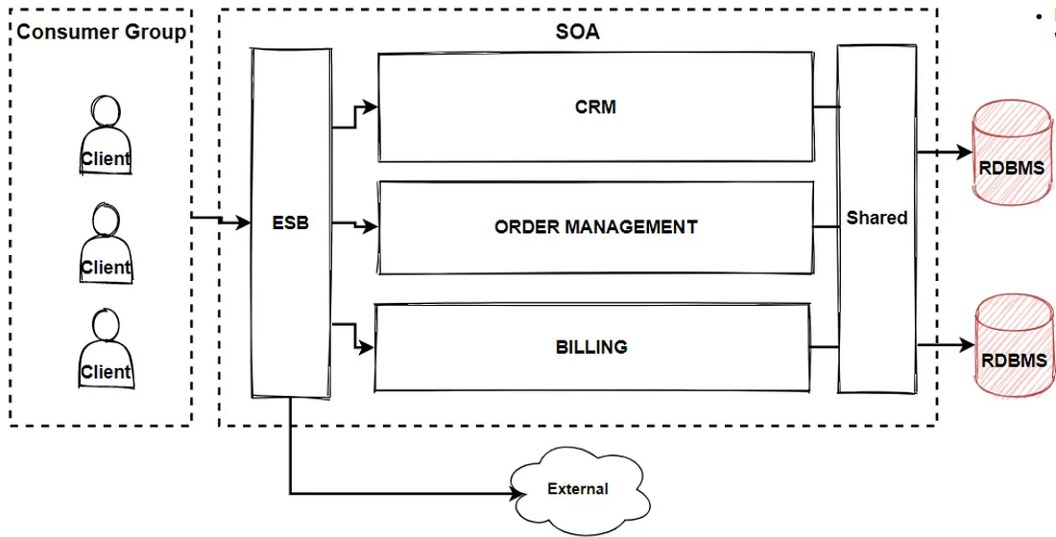
Service-Oriented Architecture
Software components are designed as reusable services
Services communicate through standardized interfaces
Communication via ESB
Services can be reused as independent components

Slide 18
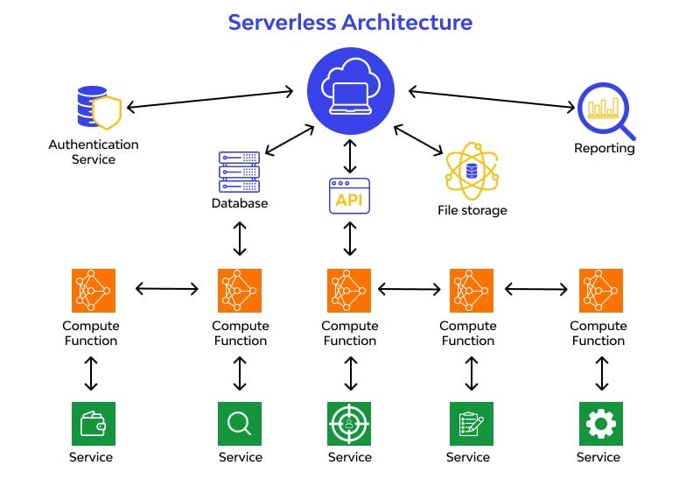
Serverless Architecture
Serverless architecture is a cloud computing model
Functions are stateless
Function-as-a-Service (FaaS)
Scales automatically in response to demand
Pay only for the resources consumed during function execution
Allows to focus on writing application code rather than managing infrastructure
Functions may experience latency during cold starts
Dependency on proprietary platforms

Slide 19
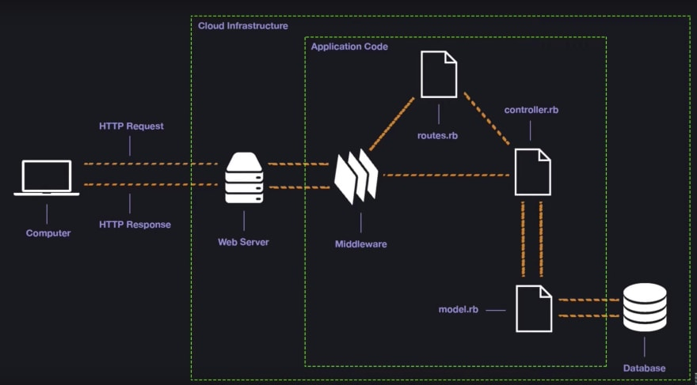
Server Components
Web Server
Load Balancer
Reverse Proxy
Cache Server
Application Server
API Gateway
Middleware
Router
Authentication
Service
Authorization
Business Logics
Data Access
Database

Slide 20
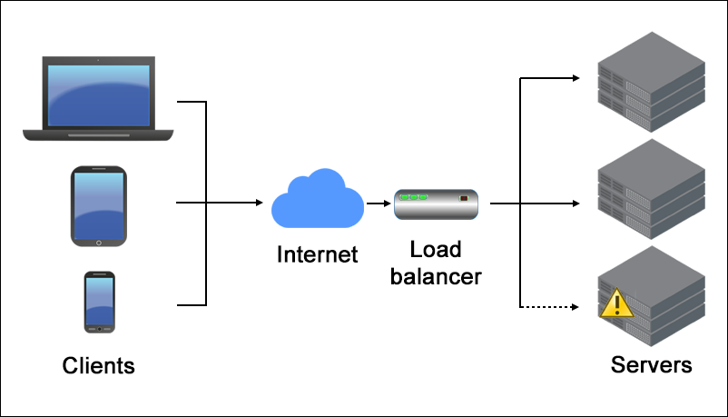
Load Balancer
Distributes requests across backend servers
Checks the health and availability of servers
Maintains session persistence
Offloads SSL/TLS encryption and decryption
Algo:
Round Robin
Least Connections
Weighted Round Robin
IP Hash
Type:
Hardware
Software
Cloud

Slide 21
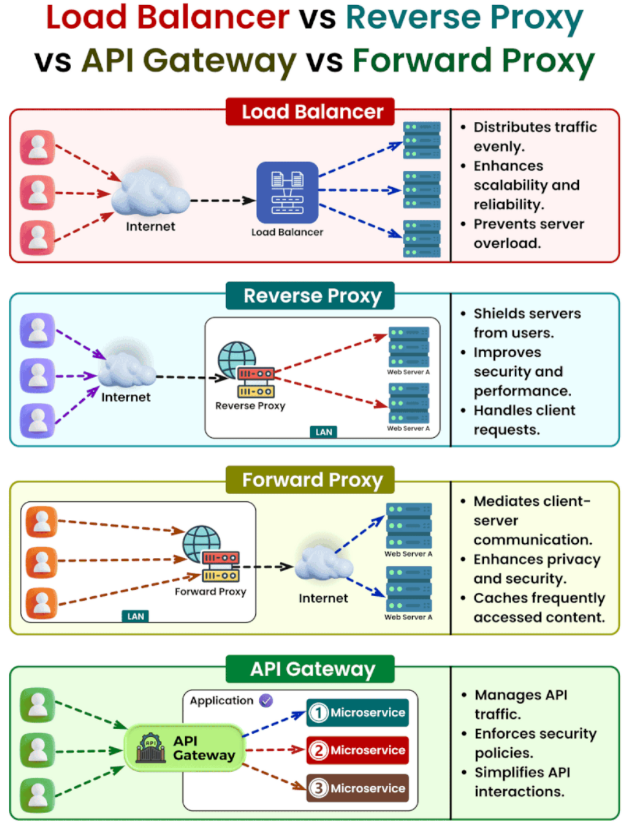
Reverse Proxy
Special case of load balancer
Distributes incoming traffic
Terminates SSL/TLS encryption
Caching
Handles static data
Protecting against attacks such as DDoS, SQL injection, and cross-site scripting (XSS)
Examples:
Nginx
Apache HTTP Server

Slide 22
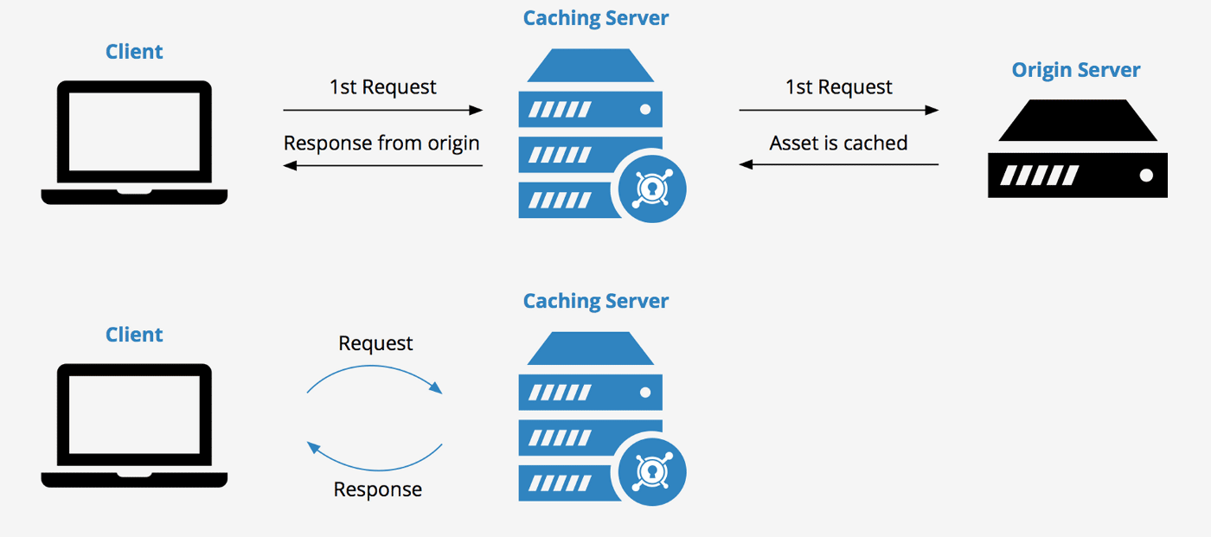
Cache Server
Stores copies of frequently accessed data
Improves response times and reduces server load
Implements strategies to invalidate or expire cache:
Time-Based Invalidation
Event-Based Invalidation
Version-Based Invalidation

Slide 23
API Gateway
Entry point for APIs
Centralized management, security, and access control
Enforces authentication
Limits the number of requests
Transforms incoming requests or responses to match the requirements
Logs API requests and responses
Supports API versioning and documentation
Components:
Middlewares
Router
Types:
Server
Microservice
Module

Slide 24
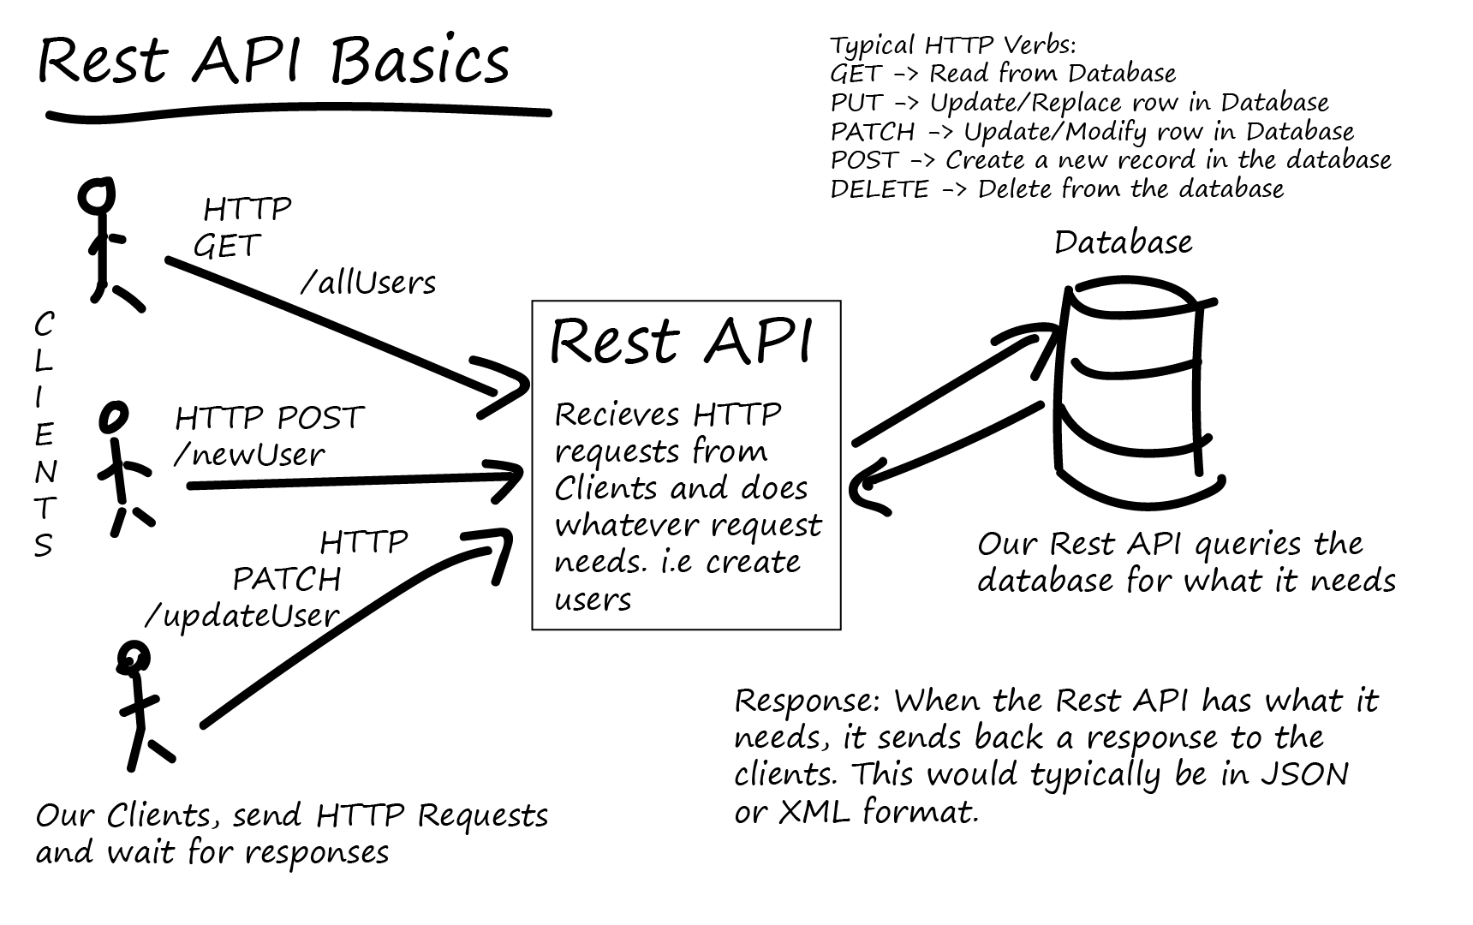
RESTful API
REST (Representational State Transfer)
Resources are identified by URIs
CRUD (Create, Read, Update, Delete) operations are mapped to standard HTTP methods: GET, POST, PUT, DELETE
The server does not store client state between requests
Uniform and well-defined interface, using standard HTTP methods and representations (JSON or XML)
Messages exchanged between clients and servers include metadata that describes how to process them
Hypermedia as the Engine of Application State (HATEOAS)

Slide 25
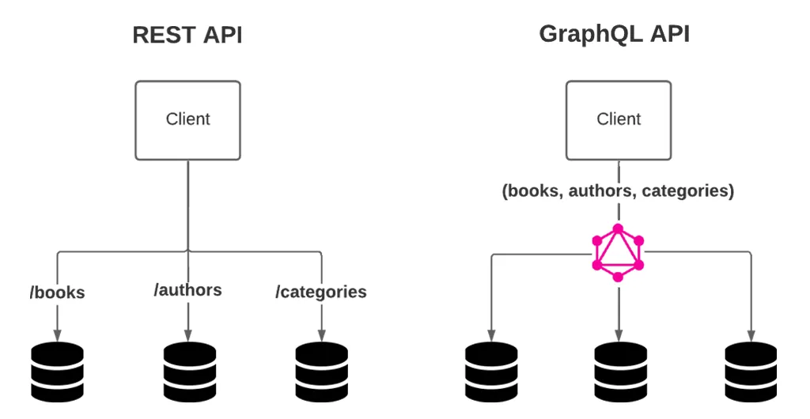
GraphQL
Clients query data from a single endpoint
Queries mirror the shape of the requested data
APIs are defined by a strongly typed schema
Clients specify the structure and shape of the data they require
Supports nested queries

Slide 26
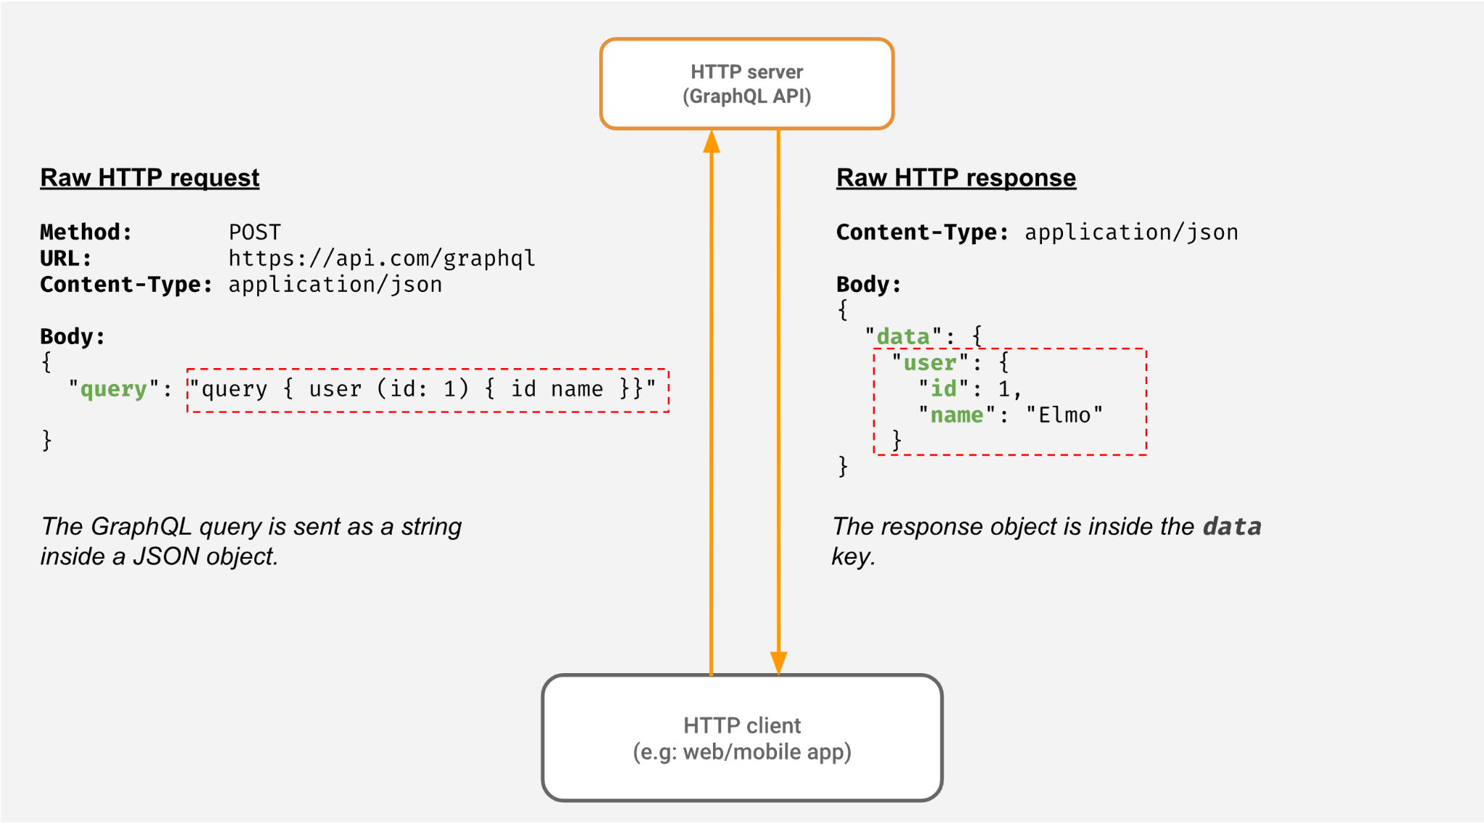

Slide 27
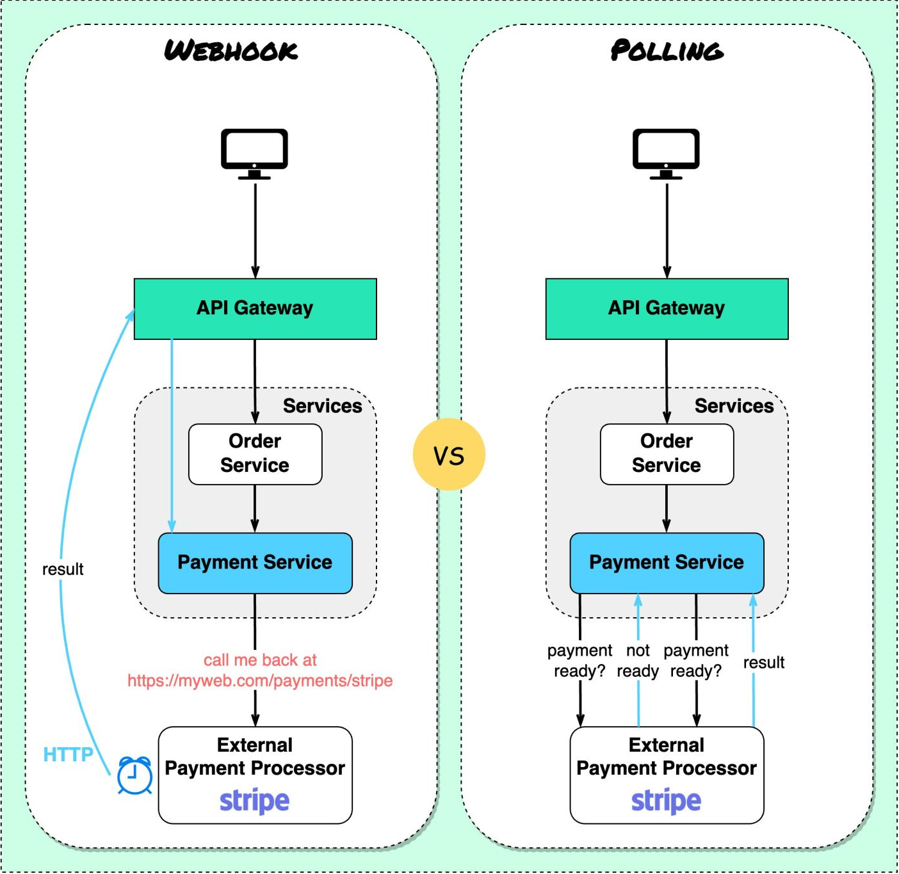
Webhooks
User-defined HTTP callbacks triggered by specific events
Event-driven communication between systems
Webhooks operate asynchronously
Contains payload with relevant data
Use cases:
Notifications
Data Synchronization
Workflow Automation

Slide 28
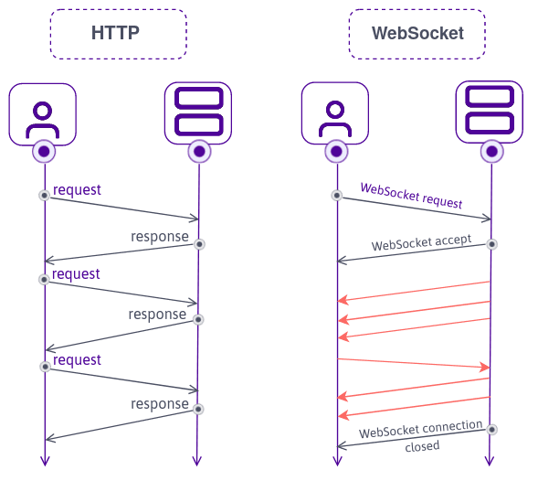
WebSockets
Bidirectional communication between clients and servers
Provides low-latency communication
Can be secured using TLS/SSL encryption
Use cases:
Real-Time Data Update
Multiplayer Gaming
Live Broadcasting

Slide 29
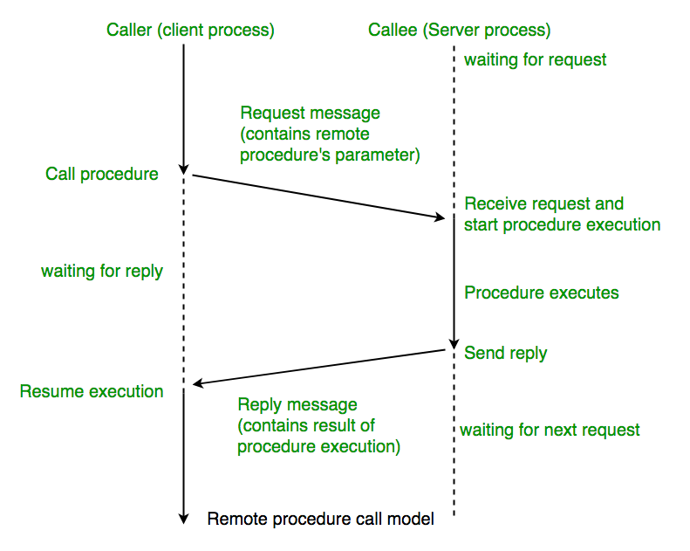
RPC
Remote Procedure Call (RPC)
Invoke functions or procedures on a remote server as if they were local
Hides the complexities of network communication
Language-Independent
Protocols:
gRPC
JSON-RPC
XML-RPC

Slide 30
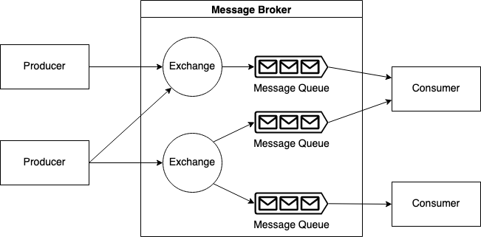
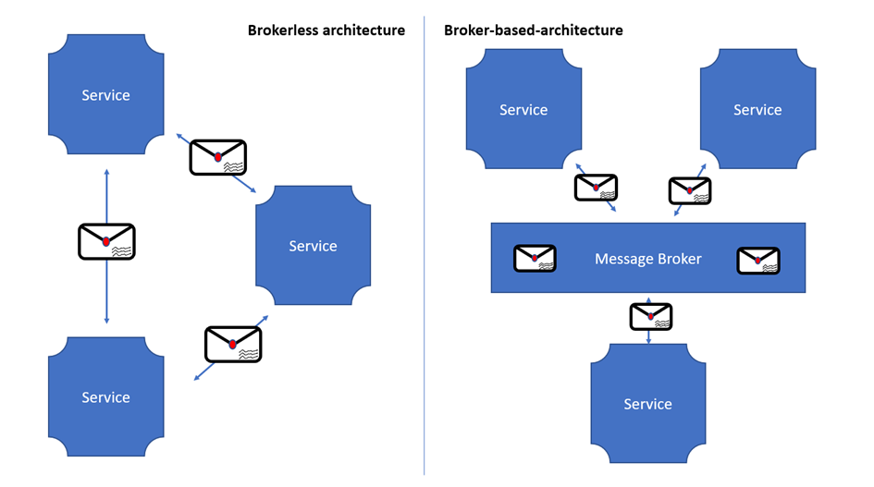
Message Brokers
Provides a message queue where senders can publish messages and receivers can subscribe
Routes messages from producers to the appropriate consumers
Ensures message durability by storing messages persistently until they are consumed
Allows messages to be transformed or enriched
Types:
Broker-Based: RabbitMQ, Kafka
Brokerless (Pub/Sub): MQTT, NATS
Use cases:
Event-Driven Architecture
Microservices communication

Slide 31
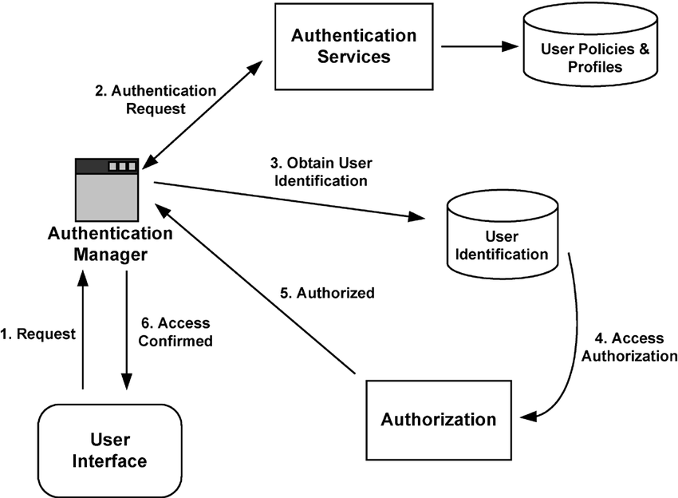
Authentication
Authentication is the process of verifying the identity of a user
Users provide an identifier to authenticate themselves (login, email)
Users provide credentials to prove their identity (password, token)
Authentication factors:
Knowledge (password)
Possession (security token)
Inherence (biometric data)
Multi-Factor Authentication (MFA)

Slide 32
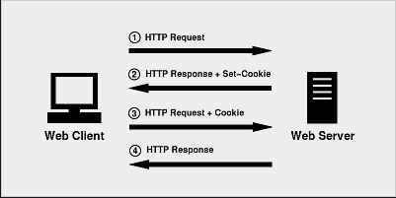
Session
Sessions are initiated when a user authenticates
The system assigns a unique session identifier (session ID)
Sessions can be terminated by logging out or after a predefined period of inactivity
Storage types:
Client side (cookies, local storage)
Server side (database, in-memory cache)
Use cases:
Authentication
Personalization
User Storage
Web Analytics

Slide 33
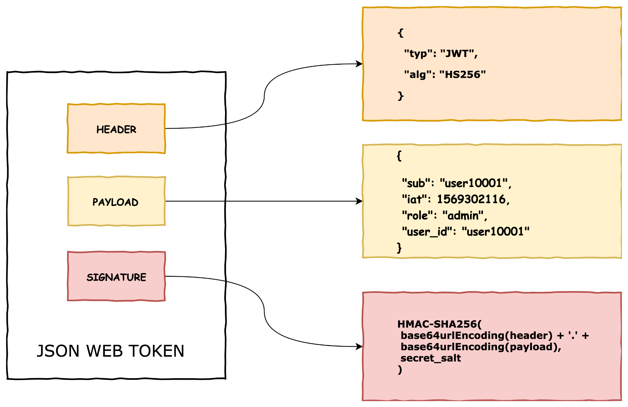
JWT
JSON Web Tokens (JWT) are a compact, URL-safe means of representing claims to be transferred between two parties
JWTs contain all the necessary information about the user or session
JWTs can be signed using a secret key or asymmetric algorithm
JWTs can include an expiration timestamp
Public keys can be shared by JWKS

Slide 34
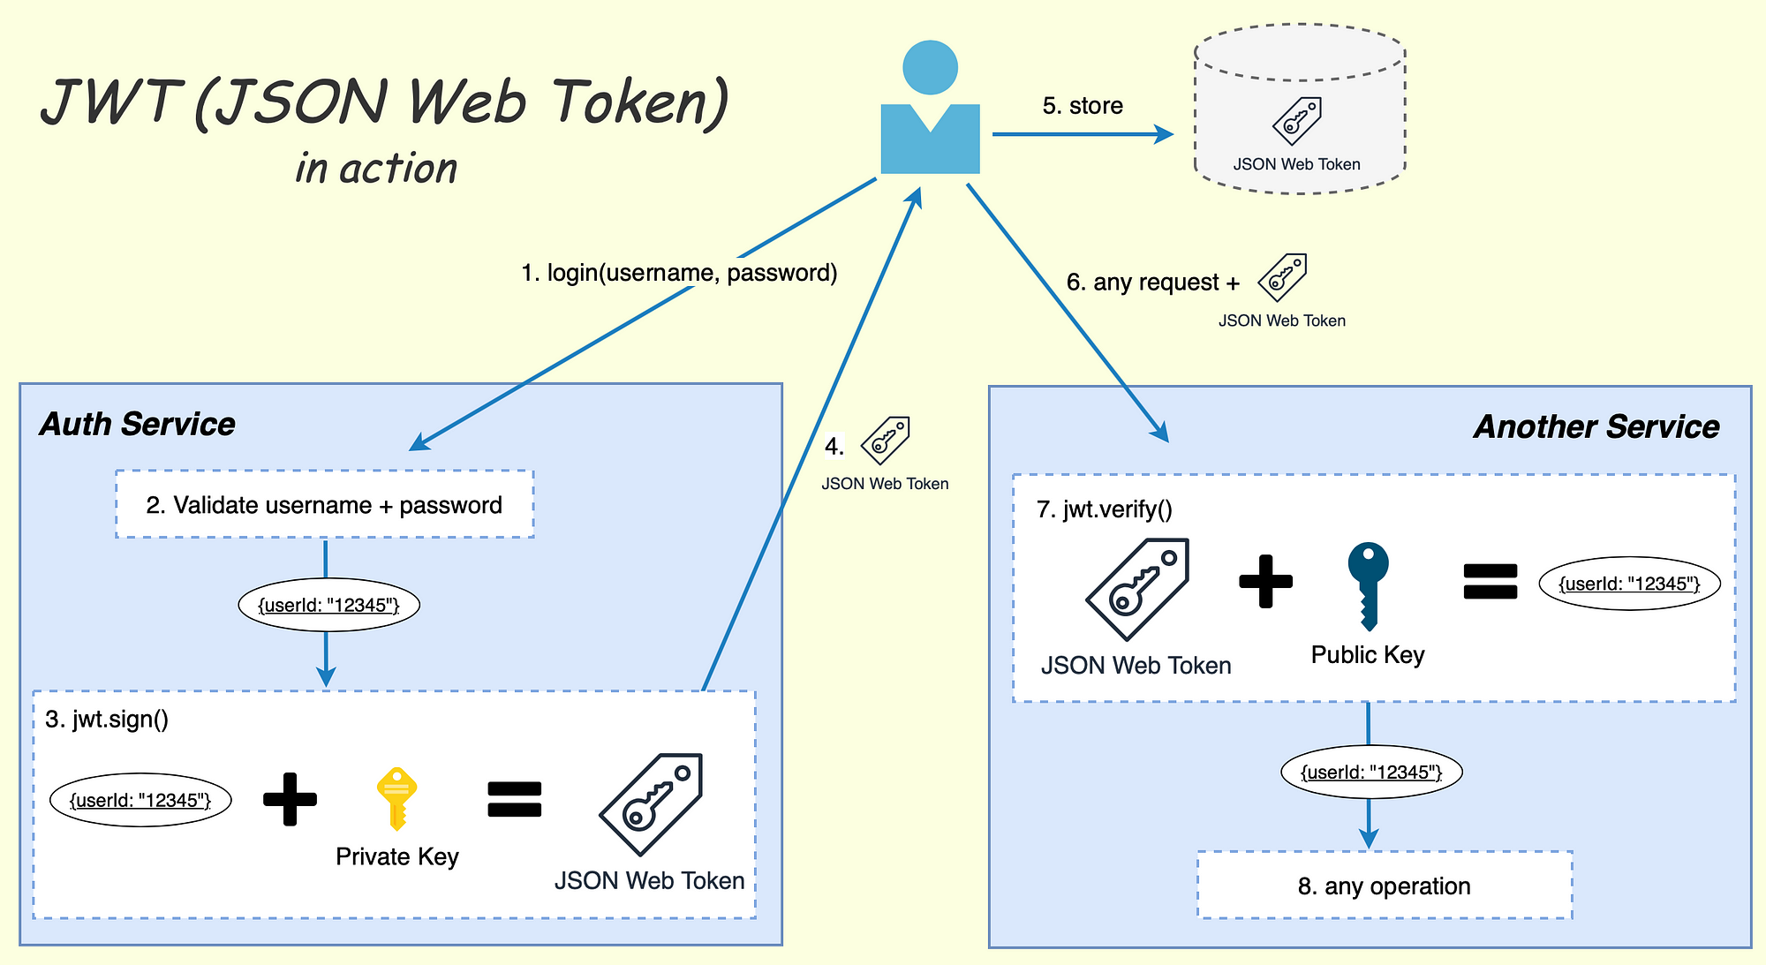

Slide 35
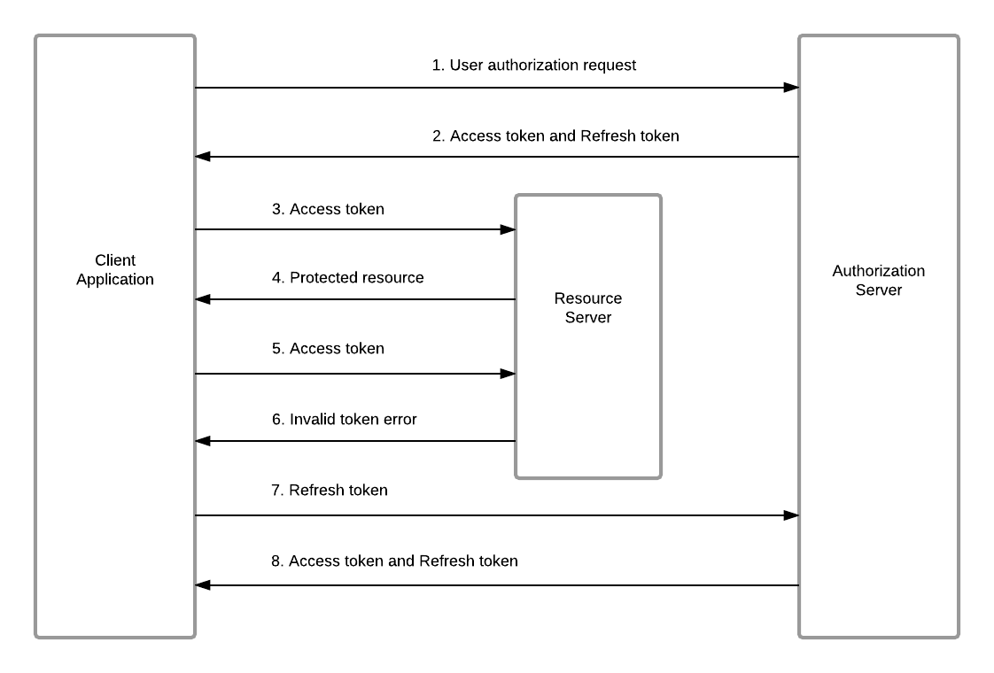
OAuth 2.0
Authorization protocol
Users can grant limited access to their resources without sharing their credentials
Follows standardized protocols and flows
Supports SSO

Slide 36
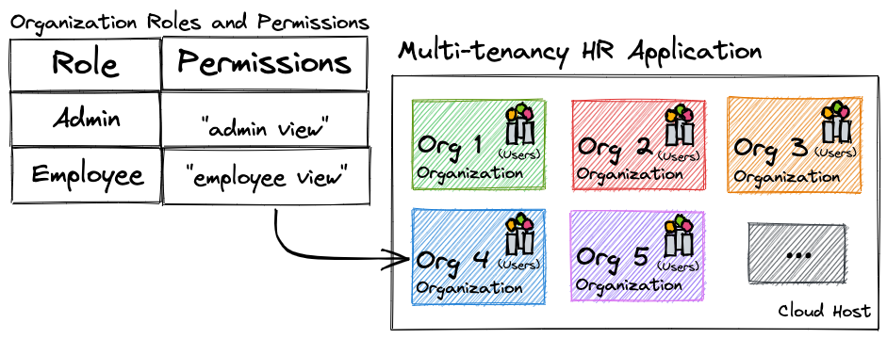
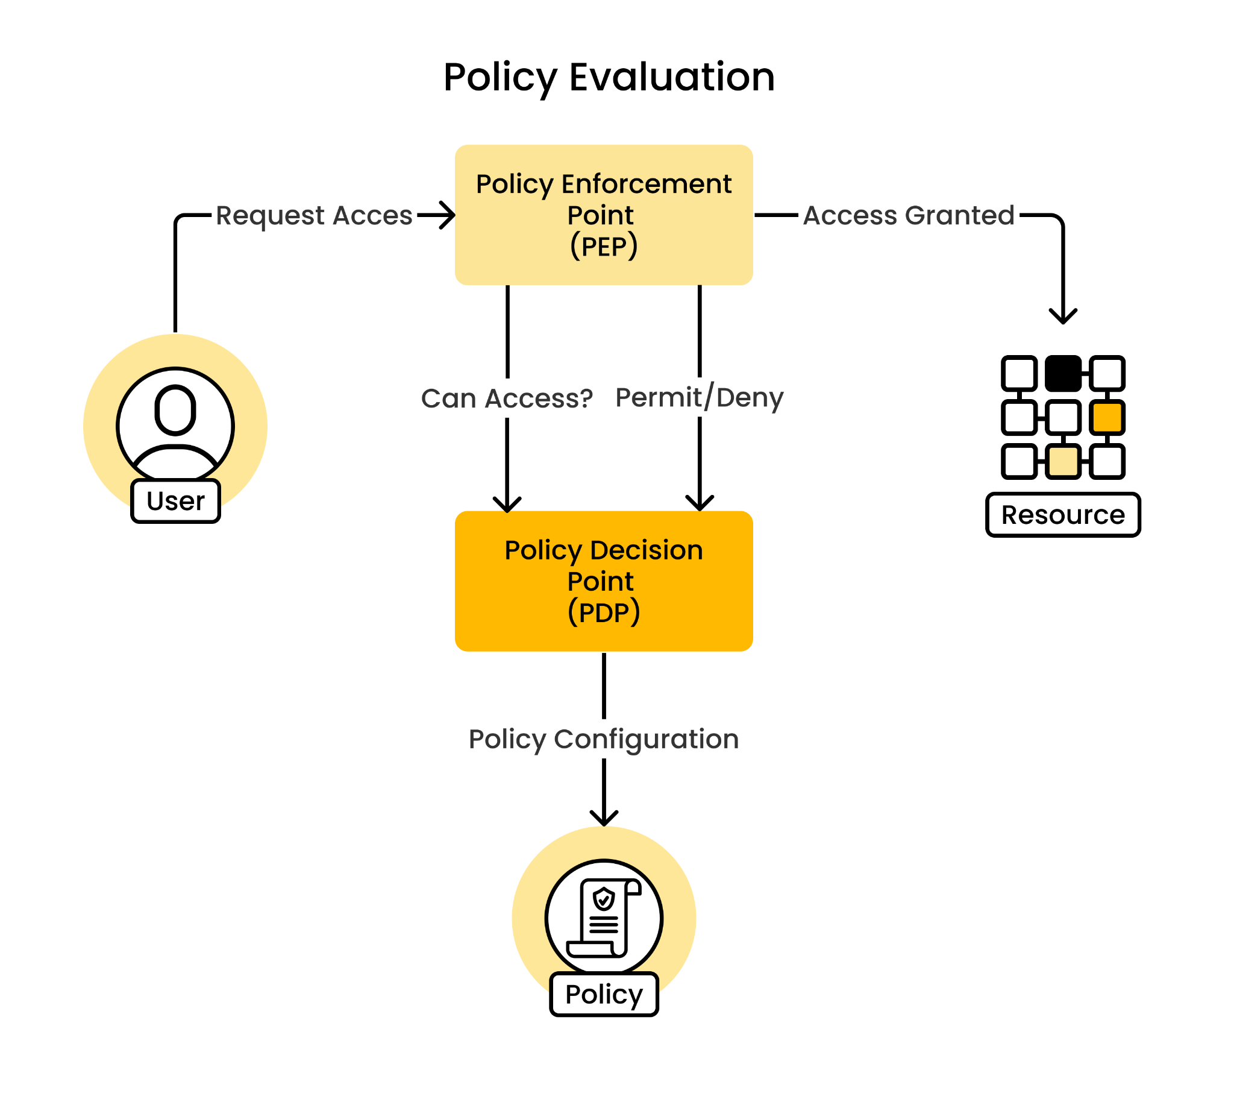
Authorization
Authorization is the process of determining whether a user has privileges
Enforces policies and control access to resources
Users are assigned roles that represent a set of permissions or privileges
Prevents unauthorized access
Ensure compliance with regulatory requirements
Types:
Role-Based
Attribute-Based
Rule-Based

Slide 37
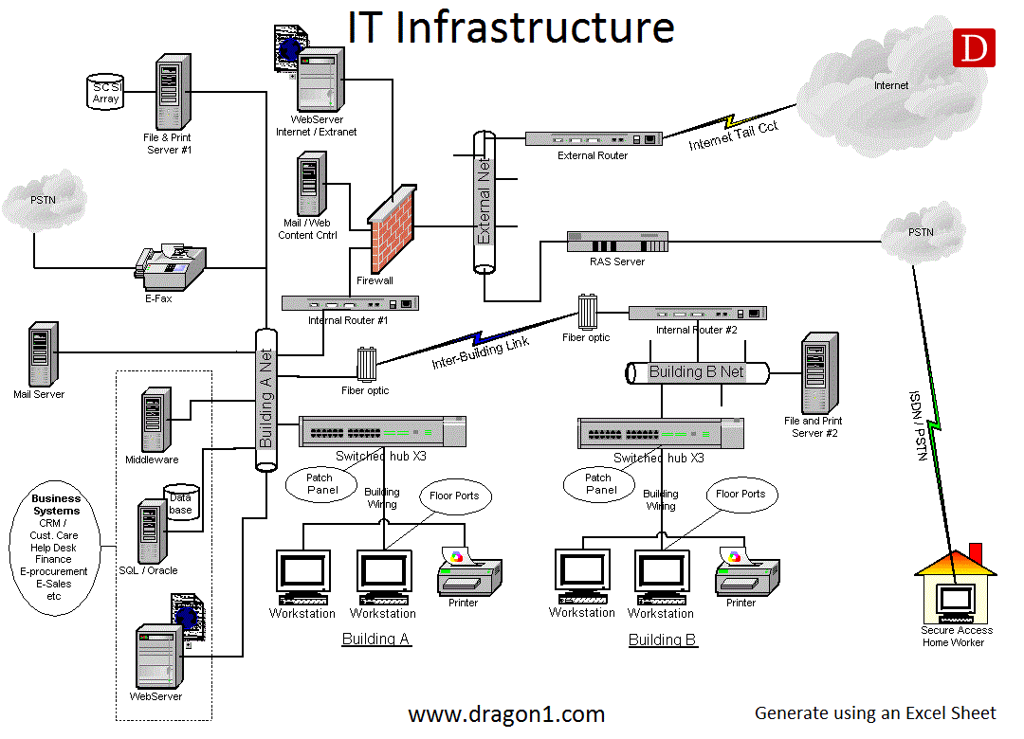
Infrastructure
Integrated framework to support the operation, management, and delivery
Hardware
Servers
Networking Equipment
Data Centers
Network
Local Area Network (LAN)
Virtual Private Network (VPN)
Content Delivery Network (CDN)
Domain Name System (DNS)
Software

Slide 38
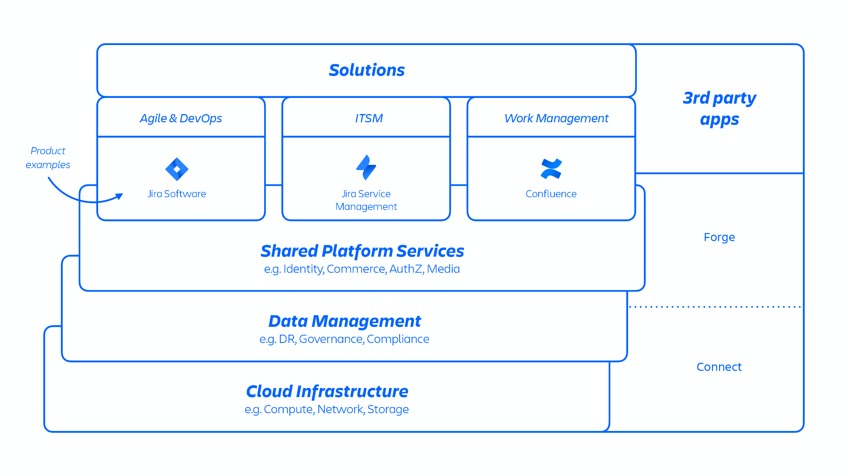
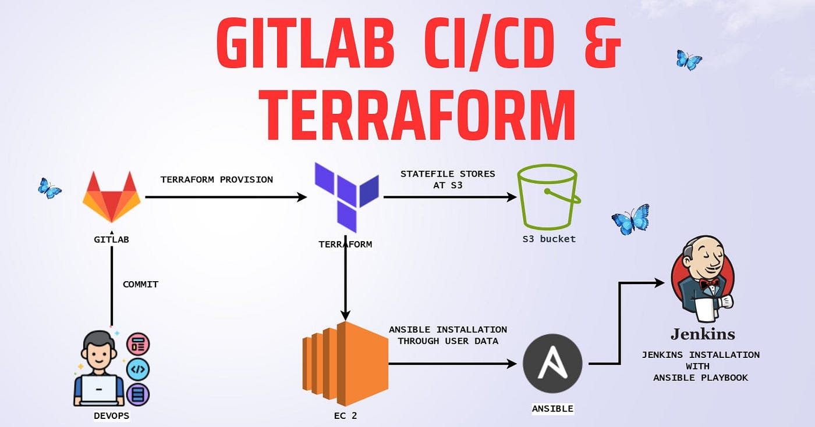
Software Infrastructure
Development
Frameworks and Libraries
Web Servers
Databases
Version Control Systems
Integrated Development Environments (IDE)
Delivery
Hosting Platform
CI/CD Tools
Container Orchestration Platforms
Management
Project Management Systems
Knowledge Sharing Platforms
Communication Platforms
Monitoring & Analytics Systems

Slide 39
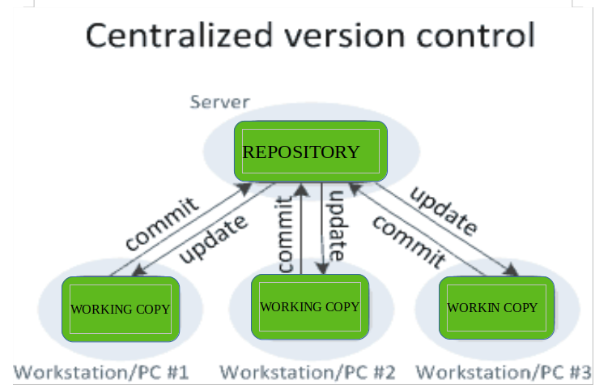
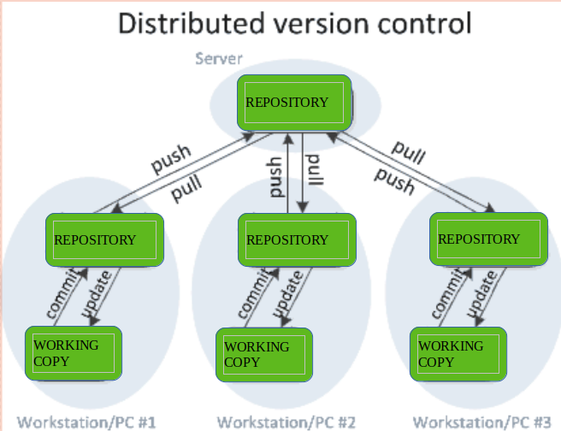
Version Control Systems
Source code management
Manage concurrent edits, merging changes, and resolving conflicts
Release management
Detailed history of changes
Backup and recovery mechanism
Allow code review processes
Examples:
Git (GitHub, GitLab, Bitbucket)
Subversion

Slide 40
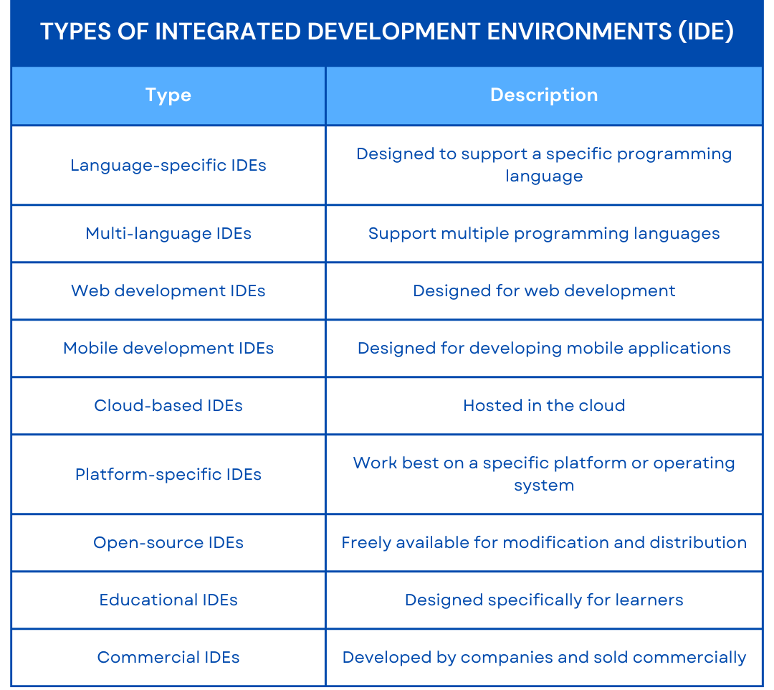
Integrated Development Environments
Software development facilitator
Code editing
Syntax highlighting
Code completion
Code debugging
Breakpoints
Inspection
Stepping
Compiling
Resource Management
File management
Navigation
Integrations
Examples:
VSCode
RubyMine
Vim/Emacs

Slide 41
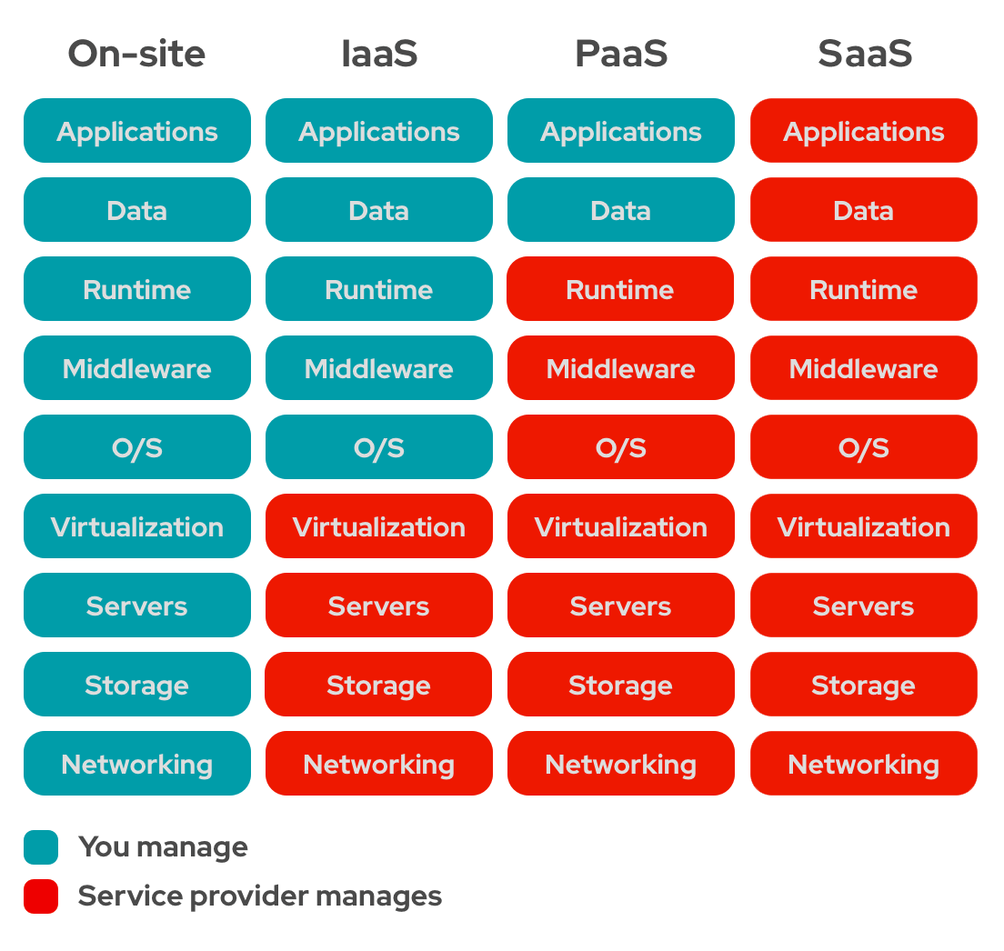
Hosting Platforms
Provide infrastructure and services for hosting
Scale up or down based on demand
Security by firewalls, encryption, and access controls
Reliability by redundancy, failover mechanisms, and data replication
Examples:
Amazon Web Services (AWS)
Microsoft Azure
Google Cloud Platform (GCP)
Heroku

Slide 42
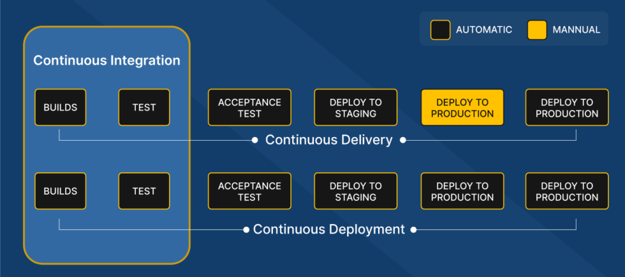
CI/CD Tools
Continuous Integration/Continuous Deployment
Automated builds
Automated testing
Automate code deployment
Version Control integration
Workflow orchestration
Examples:
Jenkins
GitLab CI/CD
Bitbucket Pipelines

Slide 43
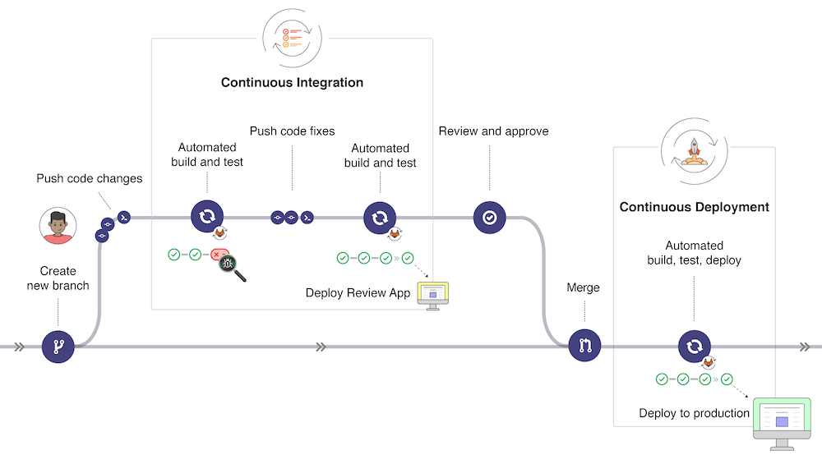

Slide 44
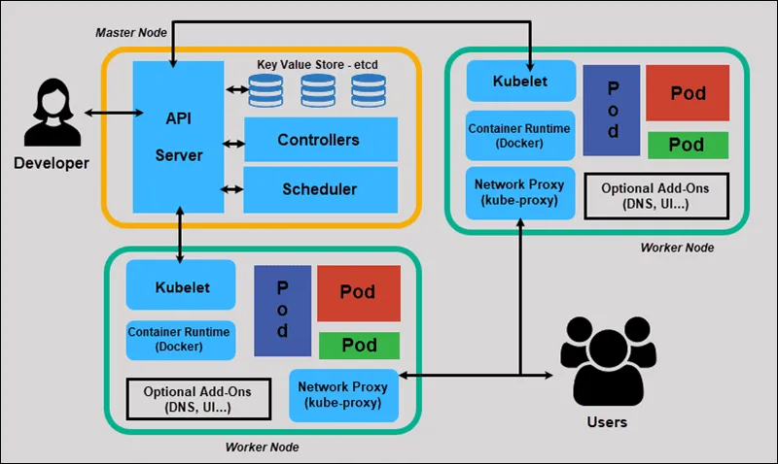
Container Orchestration Platforms
Management of containerized applications
Scaling management
Load balancing
Health monitoring
Security
Examples:
Kubernetes
Docker Swarm
Amazon EKS

Slide 45
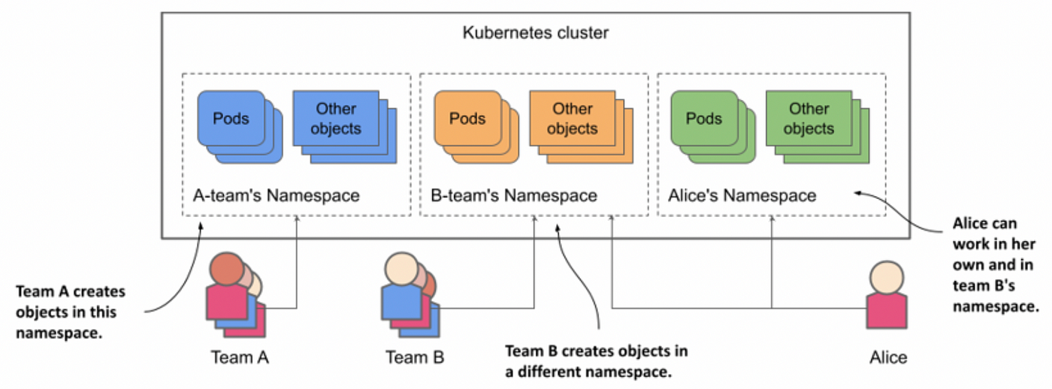
Kubernetes Namespaces

Slide 46
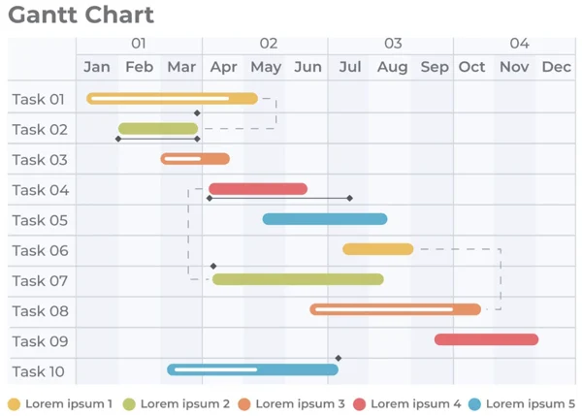
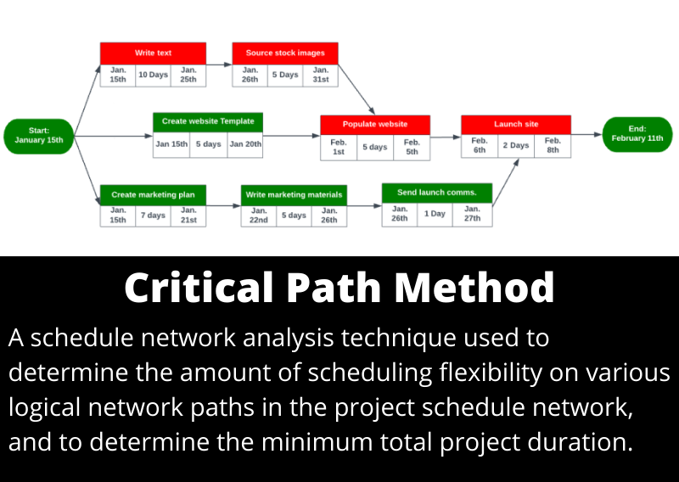
Project Management Systems
Task creation and assignment
Track task status including updates/comments/attachments
Task scheduling and prioritization
Workflow management
Reporting and analytics
Integrations
Examples:
Jira
Trello
Asana

Slide 47


Knowledge Sharing Platforms
Create, publish, and share various types of content, including articles, documents, presentations, videos, and tutorials
Search by keywords and categorization
Comment, rate, and contribute to existing content
Integration
Analytics and reporting
Examples:
Confluence
Microsoft SharePoint

Slide 48

Communication Platforms
Instant messaging channels and group chats
Provide voice and video calling features
Share files, documents, and multimedia content
Presence and status indicators
Notifications and alerts
Advanced search mechanisms
Encryption, access controls, and compliance standards
Integration
Examples:
Microsoft Teams
Slack
Zoom

Slide 49

Monitoring & Analytics Systems
Collect data from servers, applications, databases, network devices, and user interactions in real-time
Measure and monitors key performance indicators (KPIs)
Alerting and notifications
Visualize data through dashboards, graphs
Log management
Monitor system performance
Integration
Examples:
Prometheus
Grafana
Datadog

Slide 50

Thank you for your attention!

